Slide 1

IT-648: IT Risk Management
Week 6
Sonja Streuber

Slide 2
Agenda
# | Topic | Reading | Due 11:59 pm CST on Blackboard
6 | Threats and Vulnerabilities: Threat models, Threat Agent, Threat Action, Vulnerability Scanning | Agrawal 6 Other materials on Blackboard | W: Post F: Responses S: LAB_6

Slide 3
Chapter 6
Threats and Vulnerabilities

Slide 4
Overview
By the end of this week, you will be able to:
Describe and define a Threat Model
Identify Threat Agents
Determine which Actions are Needed to Respond to Threats
Identify and Manage the Remediation of Vulnerabilities

Slide 5
Introduction
Threats
Definition
Capabilities, intentions and attack methods of adversaries to exploit or cause harm to assets
NIST definition
Any circumstance or event with the potential to adversely impact organizational operations and assets, individuals, other organizations or the nation through an information system via unauthorized access, destruction, disclosure or modification of information, and/ or denial of service
Goal
Once assets are identified, identify threats for optimal information security investments
No defense necessary if no harm anticipated

Slide 6
Threat model
Definition
Interactions between relevant agents, actions and assets constitute the threat model facing an organization
Threats arise from motivated people (agents) taking specific actions to exploit assets
To understand threats
Understand relevant agents and their motivations
Understand likely assets to be affected
Understand likely actions against each asset

Slide 7
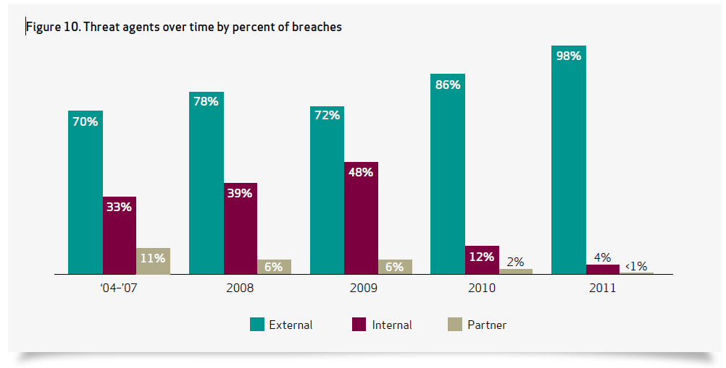
Threat agents
Definition
The individual, organization, or group that originates a particular threat action
Three types
Simple classification into MECE (mutually exclusive, collectively exhaustive) categories
External
Internal
Partners
Trends
Internal agents dropped dramatically
External agents increased significantly

Slide 8
External agents
Definition
Agents outside the organization, with no direct links to the organization itself
Categories
Activist groups (Mix political activism with cybersecurity violations, e.g. Anonymous, Lulzsec)
Auditors
Competitors
Customers
Nature
Former employees
Government (Chinese APT attacks; Mandiant report; Syrian attackers reported; Stuxnet)
Cybercrime (Nigerian 419 scam)
Organized Crime (Carder planet)

Slide 9
Internal agents
Definition
People linked to the organization, often as employees
Categories
Internal auditors (Can cause damage in the name of compliance)
Help desk
Upper management (Lack of awareness of information security concerns; often weakest link because unaware of security or force exemptions from policy)
Human resources
Janitorial staff
Software developers
System administrators

Slide 10
Partners
Definition
Third parties sharing a business relationship with the organization
Categories
Cloud service providers
Hardware and software vendors
Contractors

Slide 11
Threat actions
Definition
Activity performed by the agent in order to affect the confidentiality, integrity, or availability of the asset
New actions emerging all the time
Simple categories
Malware
Hacking
Social engineering
Physical
Error
Environment

Slide 12
Threat actions
Malware
Malicious software
Viruses
Worms
Bots
Hacking
Brute force
Poor choice of passwords
Default passwords
Cross-site scripting
Most important threat action
Eric Grosse, VP, Security Engg. @ Google, NSF meeting 2012
SQL injection
Misuse of privileges

Slide 13
Threat actions
Social engineering
Unapproved software
Phishing
Pre-texting
Physical
Unauthorized access
Theft
Error
Mis-configuration
Environment
Power and equipment outages
Natural events

Slide 14
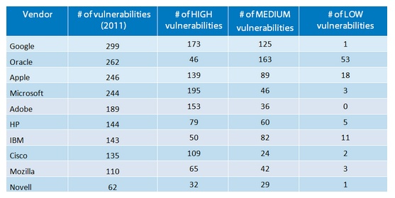
Vulnerabilities
Definition
Weaknesses in information systems that gives threats the opportunity to compromise assets
Relationship with threats
Vulnerability is not a risk without a threat exploiting it
Threat is not a risk without a vulnerability to be exploited

Slide 15
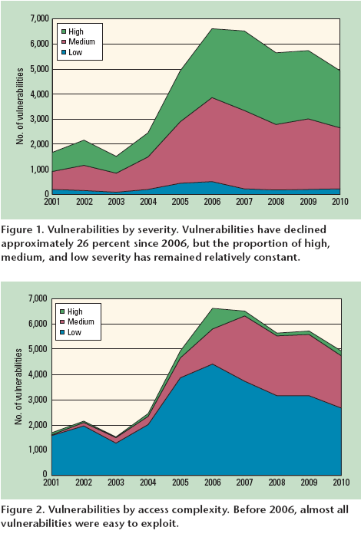

Vulnerability trends
Source:
Kuhn and Johnson, Vulnerability trends: measuring progress, IEEE IT Pro, 12(4), pg. 51-53, 2010
Google Question:
How have vulnerability trends changed between 2010 and today?

Slide 16
Vulnerability Categories
Operating system vulnerabilities
Patch Tuesday
Application vulnerabilities
OWASP top 25 list

Slide 17
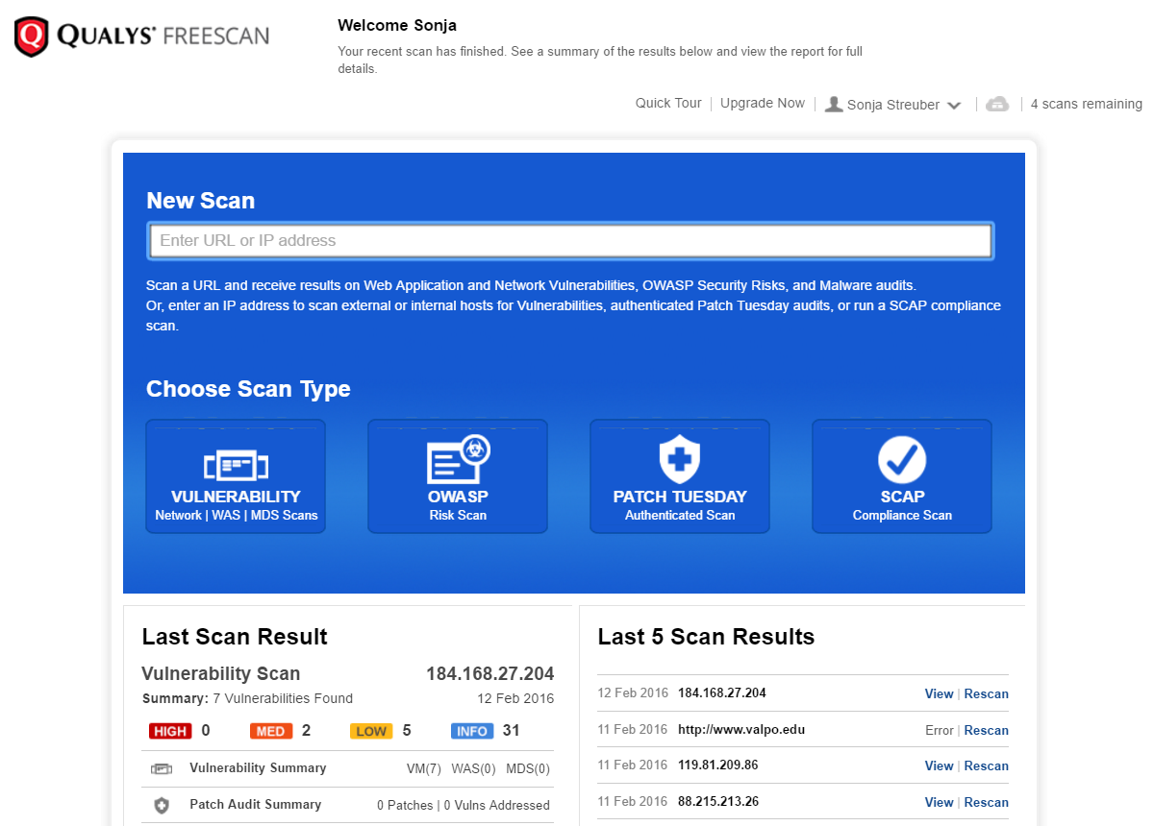
Vulnerability Scanner: Qualys
Run a scan on
A website
An IP address

Slide 18
Summary
Assets
Identification
Asset types
Characterization
Sensitivity
Criticality
Ownership
Operational responsibilities

Slide 19
Chapter Review Questions
What is a threat? Provide some examples.
What is a threat model? Why are threat models useful?
Consider your laptop as the asset. Draw your threat model for the asset.
What are threat agents? Provide some examples.
What are the different types of threat agents? How have they evolved in prevalence over time?
Describe the typical Nigerian 419 scam.
What are hacktivists?8
In your opinion, which organization in your local area would be the most likely target of a hacktivist attack? Why?
What are some known motivations of governments to sponsor or endorse cybercrime?
What are internal threat agents? Provide some exam ples. Which of these do you think is the most dangerous? Why?
How can top management be a threat agent from the per- spective of information security?
What is a threat action? What are some common threat actions?

Slide 20
Chapter Review Questions
What threat actions can originate from an outsourced IT services provider?
What is a brute-force attack? What is the objective of a typical brute-force attack?
How can former employees become threats? What can you do to minimize the threat?
What is a zero-day threat?
What is threat shifting? How does it affect the work ofinformation security professionals?
What is a cross-site scripting attack? What is the objec- tive of a typical cross-site scripting attack?
What are some threat actions that can originate from the environment?
What in your opinion is the most important threat action originating from the environment in your local area?
What are vulnerabilities?
What is the relationship between vulnerabilities andthreats?

Slide 21
Chapter Review Questions
What does patch Tuesday refer to in the information security profession?
What is OWASP? Why is it important to information security professionals?
Consider the threat model you developed for the lap- top in question 3 above. What in your opinion is the most important threat agent and threat action in your model?

Slide 22
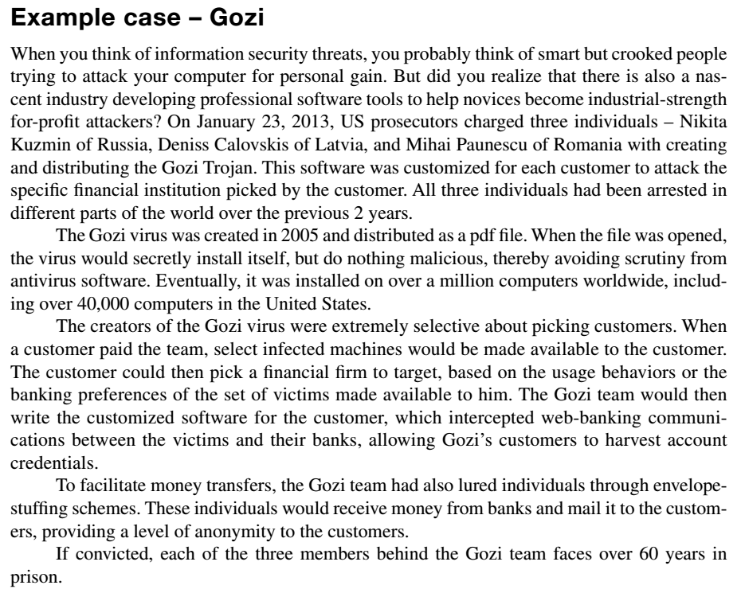
Example case: Gozi

Slide 23
Example Case Questions
Based on the information provided in the case, what suggestions would you offer to a friend to stay safe online?
What is “bulletproof” hosting? Why is it valuable to cybercriminals? (you may need to search online)
What offenses is each individual in the ring charged with committing?

Slide 24
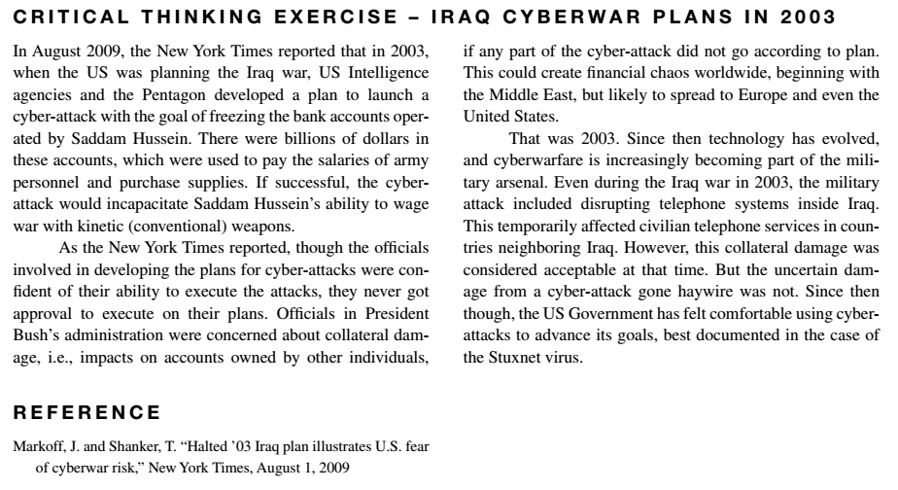
Critical Thinking Exercise

Slide 25
Critical Thinking Exercise Questions
What are some ways (however unlikely) in which the proposed cyber-attack on Saddam Hussein’s accounts could have harmed you?
What are some ways in which a cyber-attack on a military target can harm civilians?
One traditional military constraint based on the Geneva conventions and the UN Charter is called proportionality, the idea that a punishment should befit the crime. Given the risks of cyber-attacks identified in the earlier questions, do you think cyber-attacks are more likely to cause disproportional harm to civilians than conventional weapons?

Slide 26
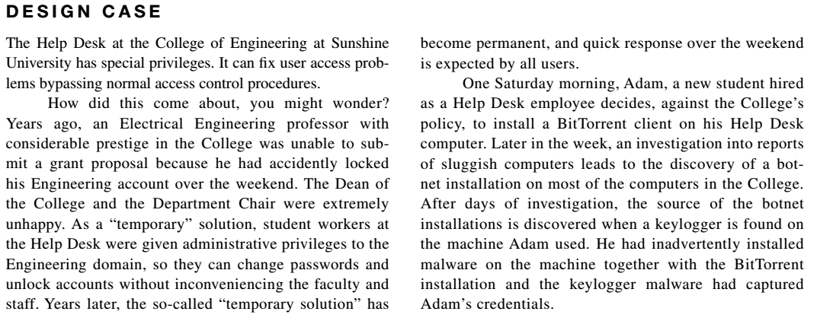
Design Case

Slide 27
Design Case Questions
The College Dean has asked you to have an incident report on his desk as soon as possible, including recommendations to prevent such incidents in the future.
List the threats and vulnerabilities that allowed this situation to occur.
Classify all the events found in 1 above, including:
Asset affected, including asset classification and characterization
Threat agent (including internal, external, or partner)
Threat action (type, etc.)
Vulnerability used
What recommendations would you make to the Dean going forward?
In your opinion, what should be done with Adam, the student recently hired to the Help Desk position?

Slide 28
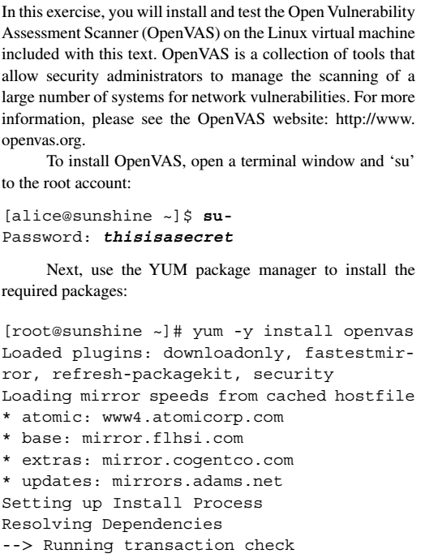
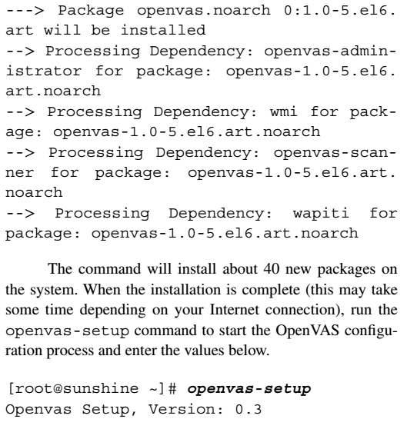
Hands-on Activity

Slide 29
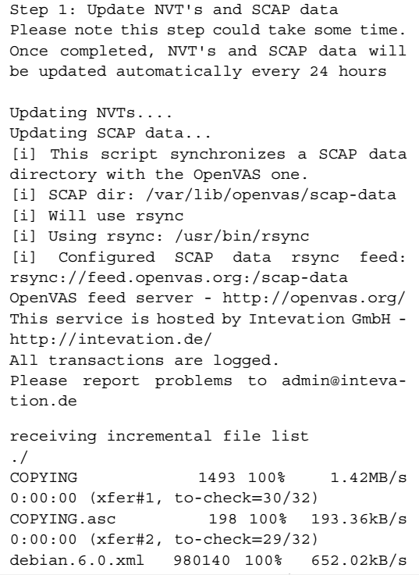
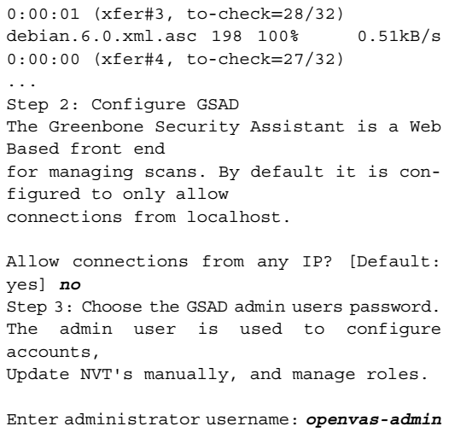
Hands-on Activity

Slide 30
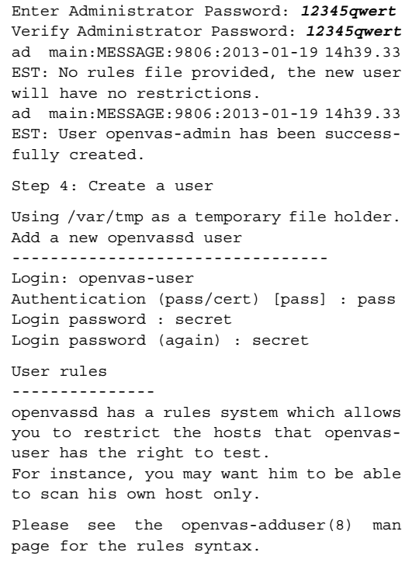
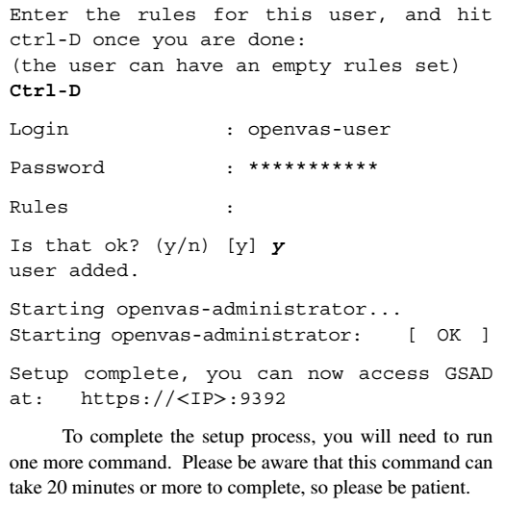
Hands-on Activity

Slide 31
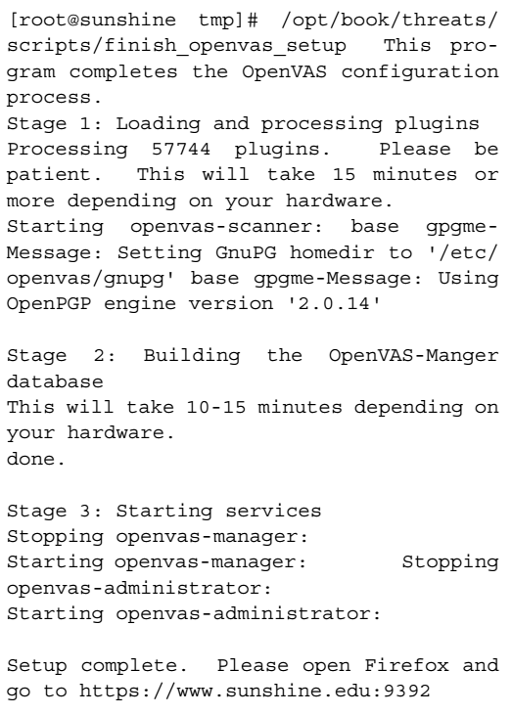
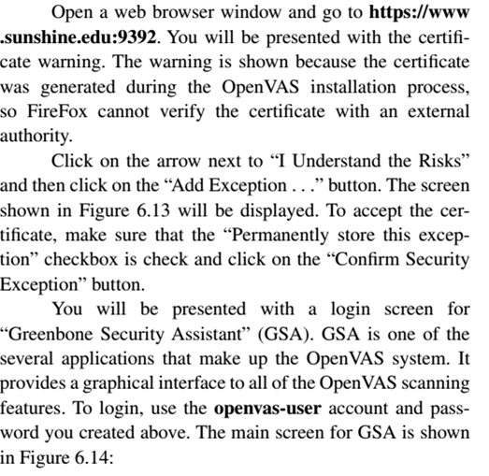
Hands-on Activity

Slide 32
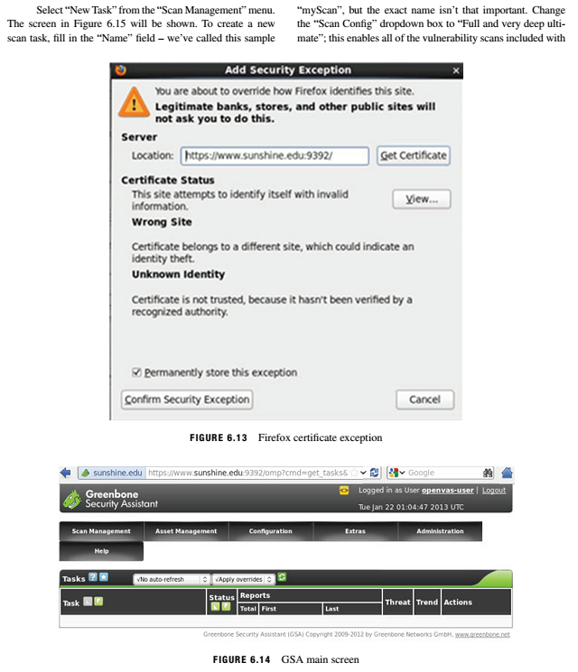
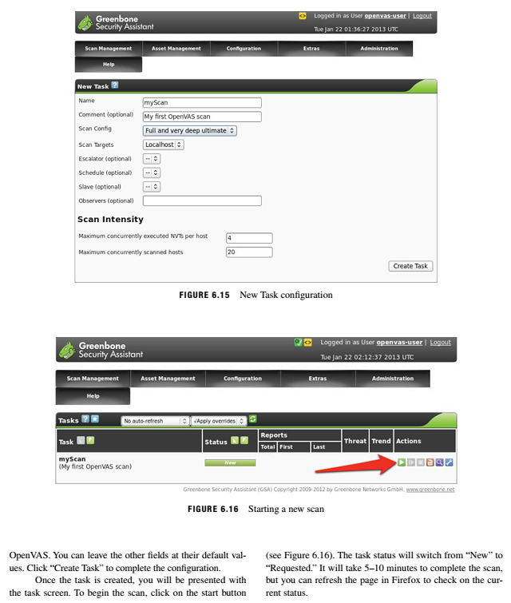
Hands-on Activity

Slide 33
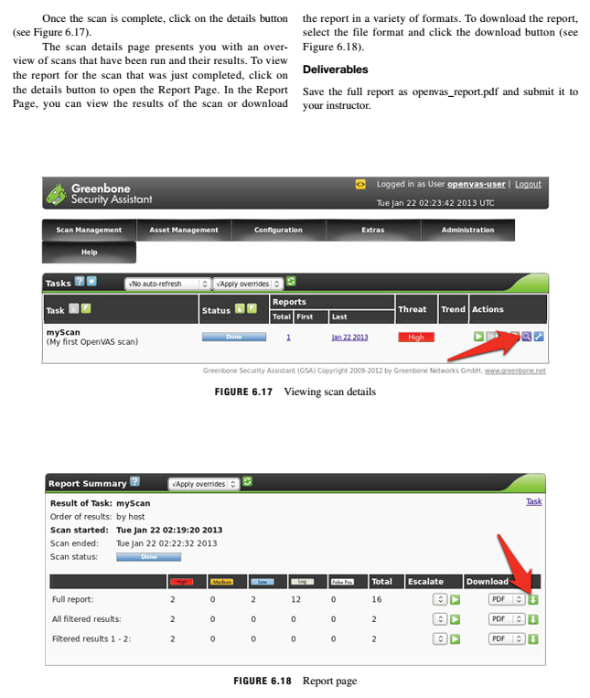
Hands-on Activity

Slide 34
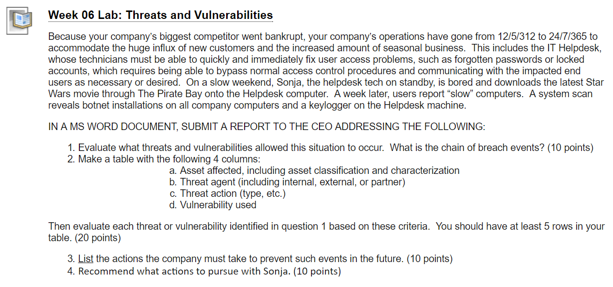
Homework Lab_6

Slide 35
Discussion 6
POST (DUE WED 11:59 pm CST): Re-read the example case about the Gozi virus, i.e. manufactured industrial-strength malware that is sold to high bidders and customized to help them attack assets of their choice. Then start doing some internet research to find a "modern-day Gozi," that is, a piece of malware (a virus, worm, trojan, ransomware etc.) or an "attack service" that is being sold today. Note the name of the malware or service, describe what it is designed to do, and, if possible when, where, and on how many users it was used "successfully."
DO NOT, UNDER ANY CIRCUMSTANCES, INSTALL ANY CODE OR COMMUNICATE WITH ANYONE ABOUT THE MALWARE OR SERVICE OFFERED. THIS IS A SILENT RECONNAISSANCE MISSION.
RESPONSES (due FRI 11:59 pm CST): As a Risk Manager for your assigned company in this course, what vulnerabilities can you expect the malware or services your peers have described to exploit? How would you defend your company's assets against this malware or these services?

Slide 36
For Next Week
# | Topic | Reading | Due 11:59 pm CST on Blackboard
7 | Encryption Controls: Encryption types and their details, Encryption in use | Agrawal 7 Other materials on Blackboard | W: Post F: Responses S: LAB_7

